Slide 1
Object Oriented Programming

Slide 2
Objects
So far, the programming style you have been using is called Procedural Programming. Procedural programming is based upon the concepts of procedure (or function) calls.
Object Oriented Programming is a programming style organized around objects. For example, you create objects that have attributes and methods in them, and they interact with other objects.
Objects are data types that group logic and data together.

Slide 3
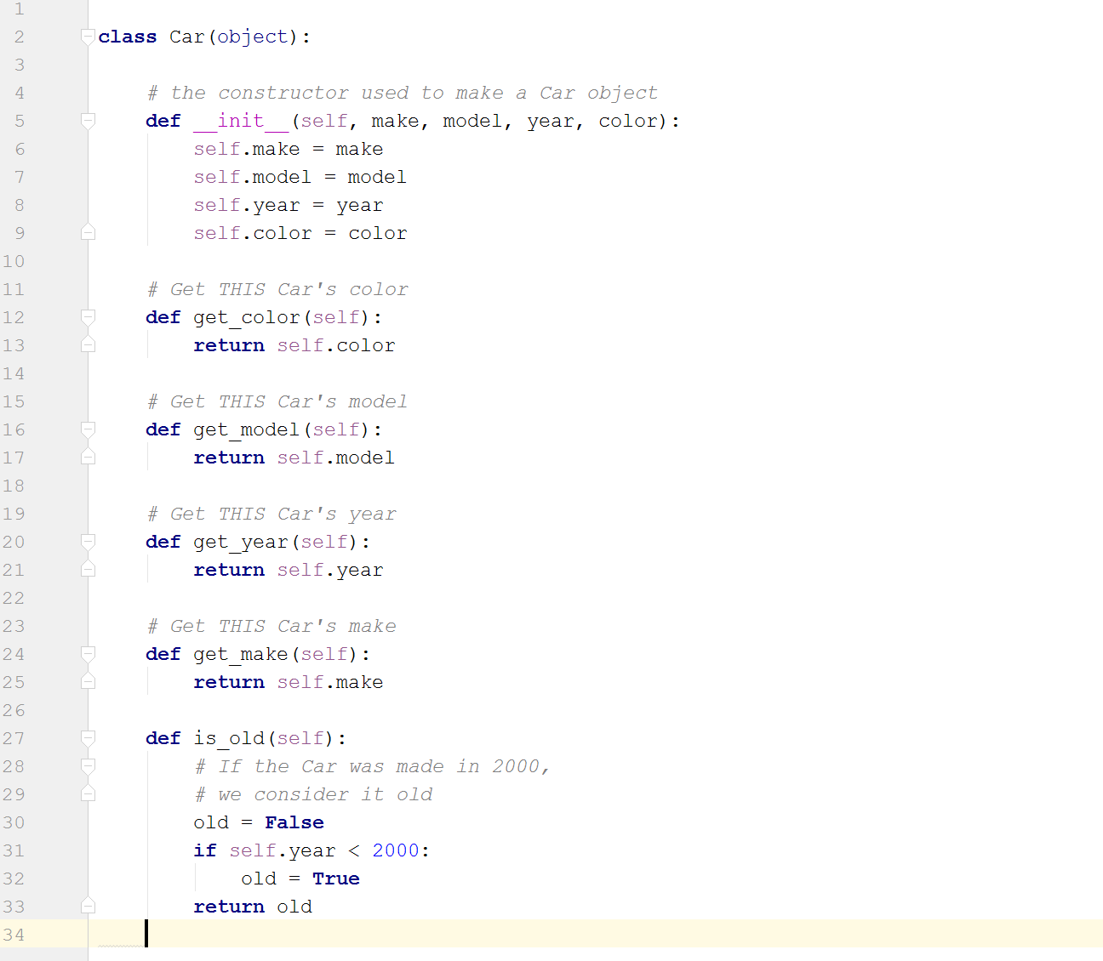
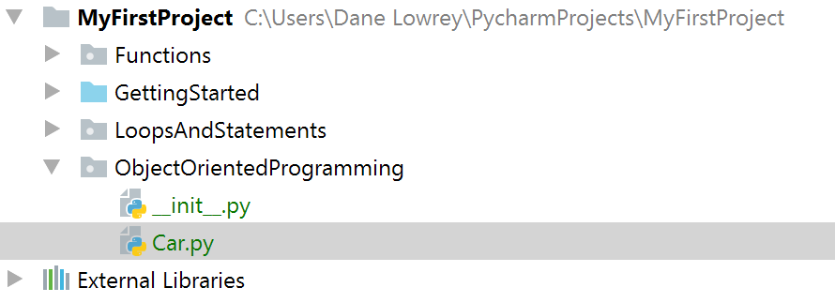
A Car object

Slide 4
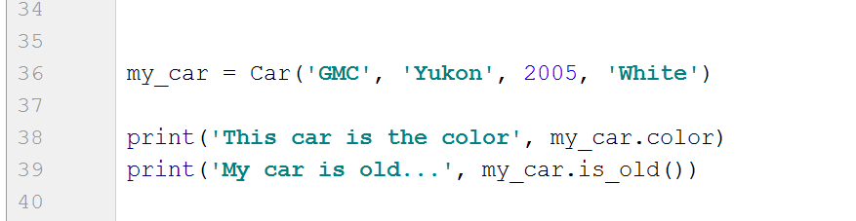
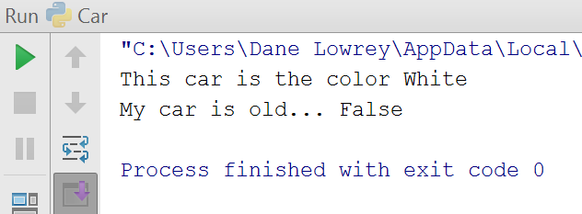
Using our new Car object
my_car.color accesses the car’s
color variable directly, you could
also use the get_color() method we defined
in the car class, i.e. my_car.get_color()

Slide 5
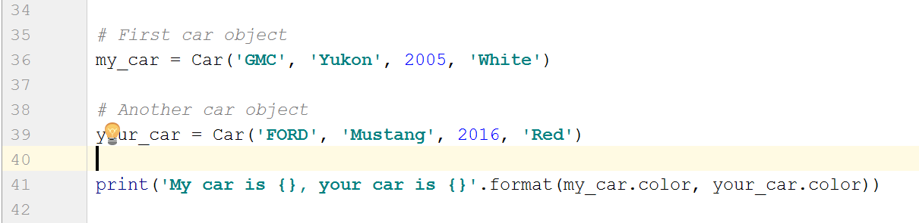
Different Instances of the Car object
Each time you “create” a new object (in our case, the car object), you will get a DIFFERENT copy each time. Meaning one car will be different from the other.
here you could also use my_car.get_color() and your_car.get_color()
The .format() is a Method of the String object, much like our Car object’s is_old() method. It allows us to put placeholders in the string denoted by {}, and then fill them in

Slide 6
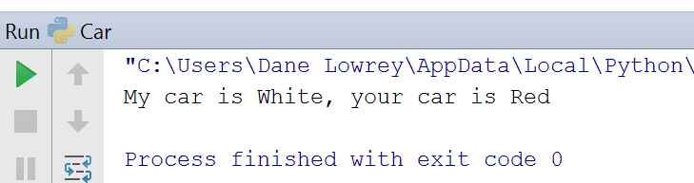

Slide 7
More of our Car object
the attributes of our Car object are:
make
model
year
color
the methods of our Car object are:
get_make()
get_model()
get_year()
get_color()
is_old()

Slide 8
Make an object representing a student
What attributes do you have as a student? What are some questions your school’s commonly ask you about classes, course info, hours, etc?
1
What are some attributes this Student object will have?
3
What are some methods this Student object will have?
4

